Slide 1

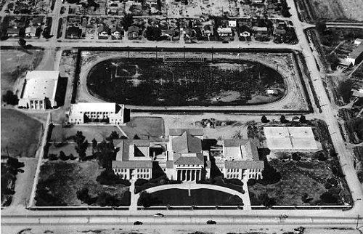
Greater Phoenix Market Update – June 2026
Tina Tamboer, Senior Housing Analyst
The Cromford Report
CromfordReport.com
Tina Tamboer
Sr. Housing Analyst
Michael Orr
Founder
1945
(81yrs ago)

Slide 2

Greater Phoenix Market Update – June 2026
Tina Tamboer, Senior Housing Analyst
The Cromford Report
CromfordReport.com
Tina Tamboer
Sr. Housing Analyst
Michael Orr
Founder
Chandler High School
350 N. Arizona Ave.
Chandler, AZ 85225

Slide 3



CromfordReport.com
Tina Tamboer
Sr. Housing Analyst
Michael Orr
Founder
And who were our export customers? In 2025, the leaders, their shares of the overall pie and total dollar amounts were:
1. Mexico – 32.8% ($14.6 billion)
2. Taiwan – 10.2% ($4.5 billion)
3. Canada – 6.3% ($2.8 billion)
4. Netherlands – 5.3% ($2.4 billion)
5. Germany – 3.6% ($1.6 billion)
6. All other countries – 41.8%
By comparison, the leaders and their portions 10 years earlier were:
1. Mexico – 40.4%
2. Canada – 10.2%
3. China – 5.6%
4. United Kingdom – 4.7%
5. Germany – 3.7%
6. All other countries – 35.4%
Story Highlights
Arizona's exports totaled $44.4 billion in 2025, growing 37% annually.
Mexico accounted for 32.8% of Arizona exports, a 63.6% year-over-year increase.
Arizona ranked No. 4 nationally in semiconductor manufacturing with 24,431 employees.
https://www.bizjournals.com/phoenix/news/2026/05/15/my-view-arizona-export-surge-explained.html

Slide 4



CromfordReport.com
Tina Tamboer
Sr. Housing Analyst
Michael Orr
Founder
1. Scottsdale 23rd
2. Tempe 26th
3. Phoenix 31st
4. Chandler 39th
5. Mesa 79th
6. Gilbert 80th
7. Glendale 96th
8. Peoria 144th

Slide 5



CromfordReport.com
Tina Tamboer
Sr. Housing Analyst
Michael Orr
Founder
U.S. News evaluated American cities according to their job market, value, quality of life and desirability. The measures were weighted to reflect a public survey of thousands of American on what they consider most important in a place to live.
Gilbert and Chandler jumped into the top 100 best places to live
U.S. News weighted housing affordability and cost of living most heavily
Nine Arizona cities made the full list of 250 locales
No. 57: Gilbert (up from No. 94 last year)
No. 78: Chandler (up from No. 123)
No. 103: Queen Creek (down from No. 93)
No. 111: Marana (up from No. 115)
No. 135: Sierra Vista (up from No. 225)
No. 145: Peoria (up from No 243)
No. 149: Scottsdale (up from No. 167)
No. 223 Surprise (new to list)
No. 245: Goodyear (new to list)
https://www.bizjournals.com/phoenix/news/2026/05/18/gilbert-chandler-us-news-best-places-to-live.html

Slide 6
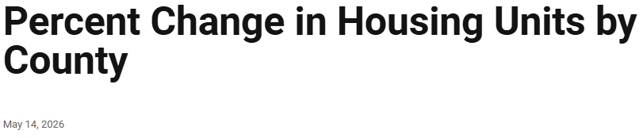
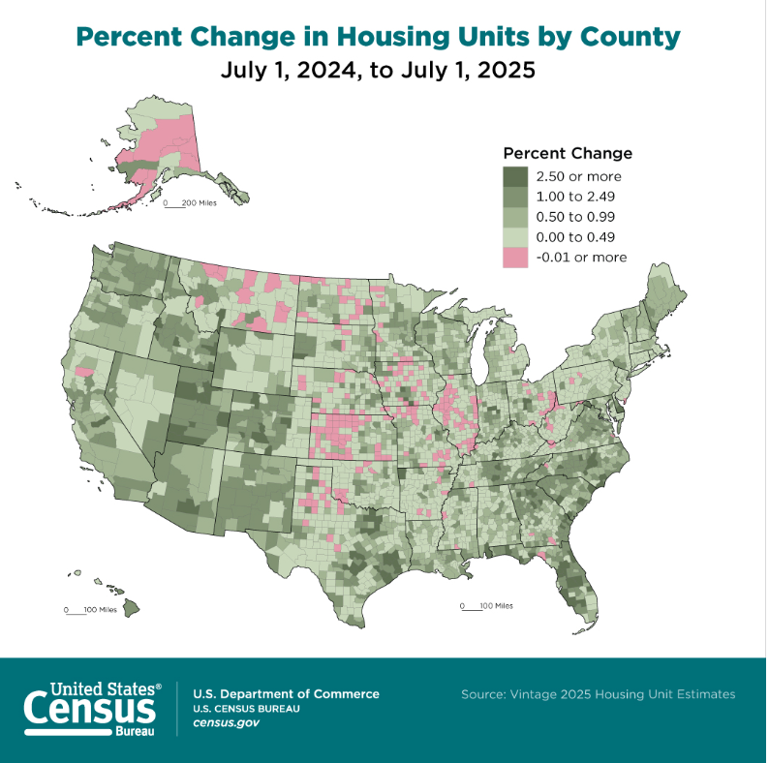

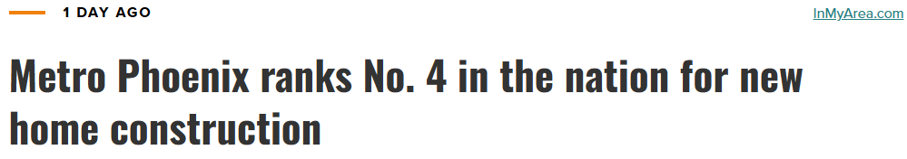

CromfordReport.com
Tina Tamboer
Sr. Housing Analyst
Michael Orr
Founder
Pinal County
May 25, 2026

Slide 7

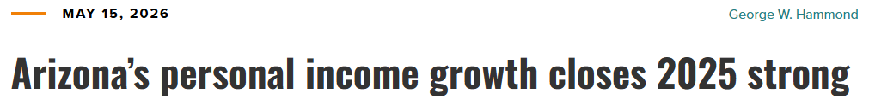
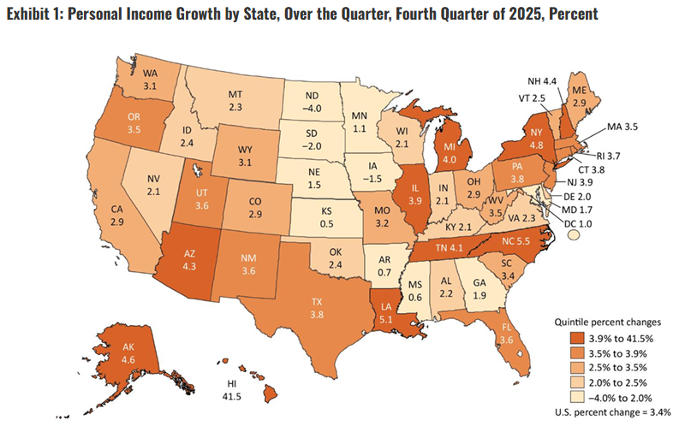
CromfordReport.com
Tina Tamboer
Sr. Housing Analyst
Michael Orr
Founder
https://azbigmedia.com/business/arizonas-personal-income-growth-closes-2025-strong/
Arizona nominal personal income rose 4.3% over the quarter in the fourth quarter of 2025, at a seasonally adjusted annual rate. That was well above the national pace of 3.4%.
In the fourth quarter, Arizona net earnings from work (wages and salaries, proprietor’s income, fringe benefits) rose 5.7% at an annual rate, well above the national pace of 4.0%.

Slide 8

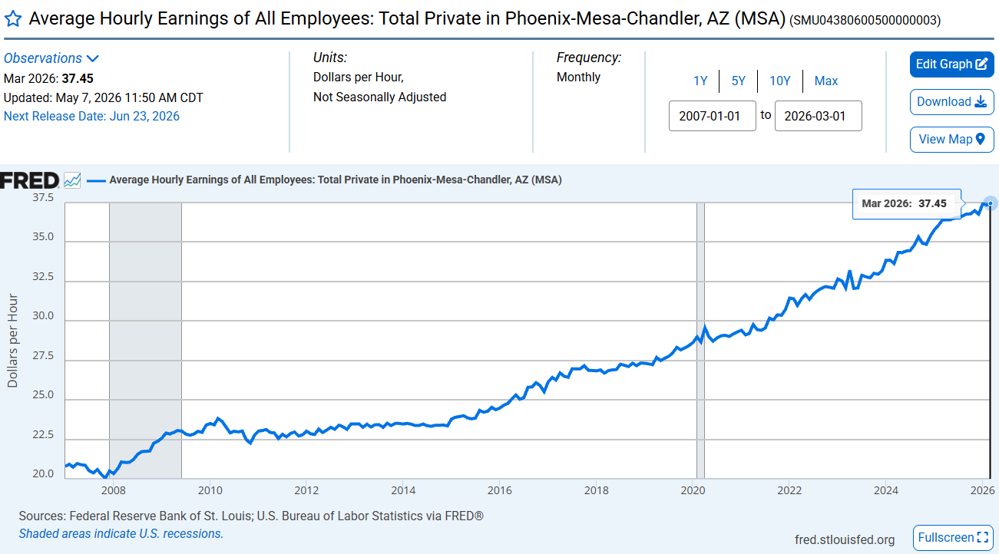
https://fred.stlouisfed.org/graph/?graph_id=1416112&rn=231
AVERAGE HOURLY EARNINGS
GREATER PHOENIX
CromfordReport.com
Tina Tamboer
Sr. Housing Analyst
Michael Orr
Founder
$37.45/hour
= $1,495 per 40hr Work Week
= $77,896 per 52 Week Year
+31%
+23%
~$59,634/yr
~$48,568/yr

Slide 9

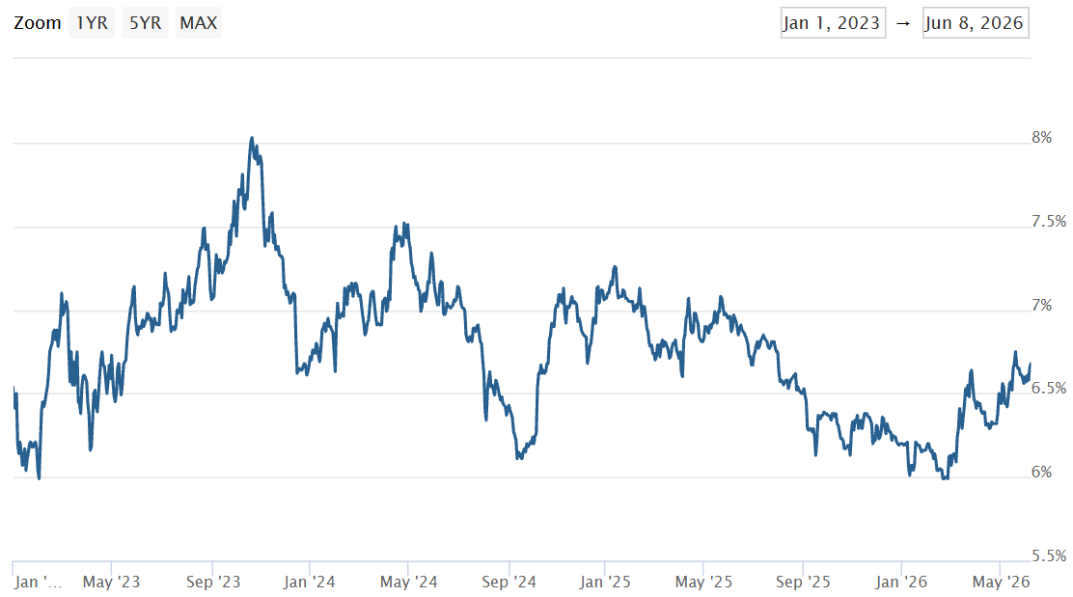
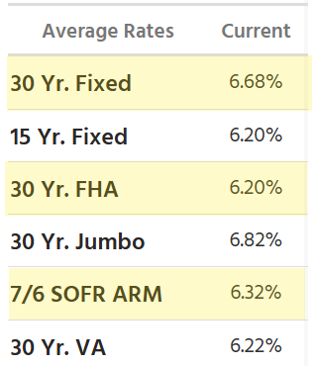


Mortgage Rates:
CromfordReport.com
Tina Tamboer
Sr. Housing Analyst
Michael Orr
Founder
https://www.mortgagenewsdaily.com/mortgage-rates/mnd
Oct 2023
8.0%
Jan 2025
7.26%
Jun 8
6.68%
6.3%
6.0%
6.1%
6.1%
Apr 17
Feb 2023
Sep 2024
Sep 2025
5.99%
Feb 2026
TALK TO YOUR LENDER ABOUT LOCAL RATES & CONDITIONS

Slide 10
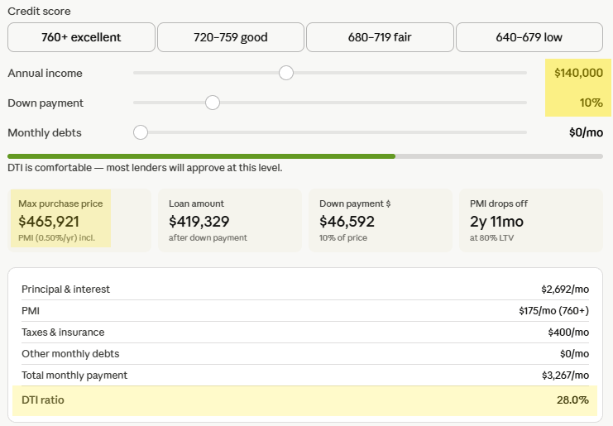
AFFORDABLE PURCHASE PRICE AT 6.65%
CromfordReport.com
Tina Tamboer
Sr. Housing Analyst
Michael Orr
Founder

Slide 11

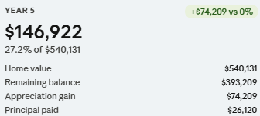
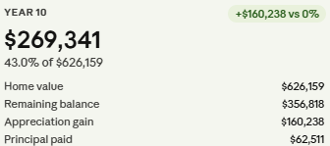
ESTIMATED FUTURE EQUITY AT 6.65% RATE & 3% APPRECIATION
CromfordReport.com
Tina Tamboer
Sr. Housing Analyst
Michael Orr
Founder

Slide 12
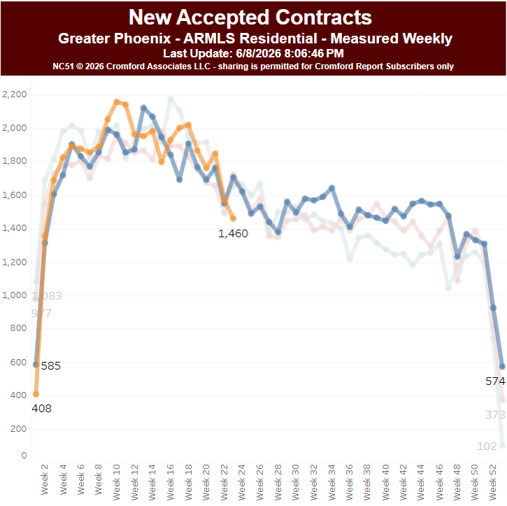


Accepted Contracts - Weekly Counts
CromfordReport.com
Tina Tamboer
Sr. Housing Analyst
Michael Orr
Founder
Apr-May
NEW CONTRACTS
Mortgage Rates
2025
Housing Industry
Memorial Day
-14.5%
2026
4th of July
Labor Day
Thanks-giving
Demand

Slide 13
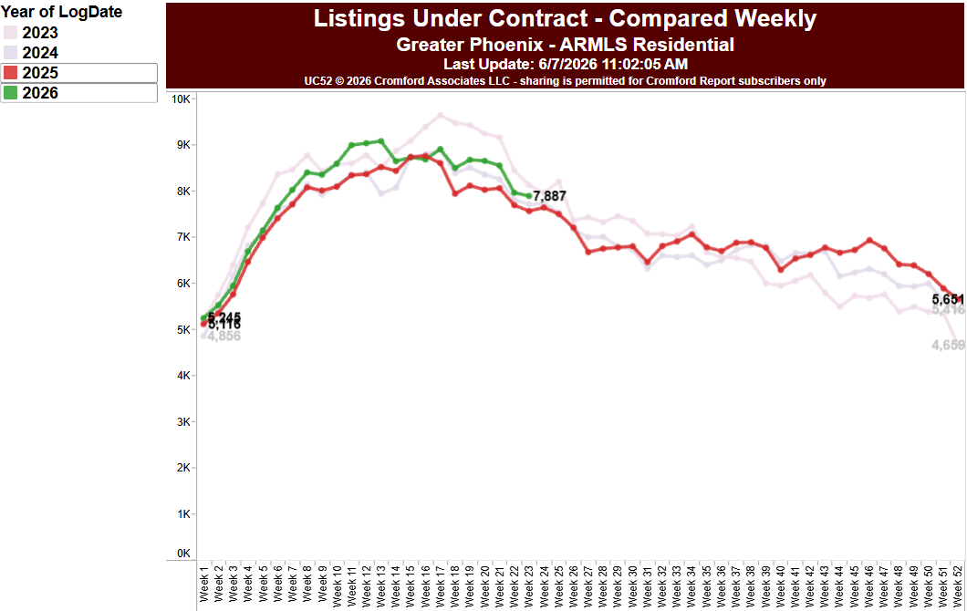

TOTAL UNDER CONTRACT- Weekly Counts
CromfordReport.com
Tina Tamboer
Sr. Housing Analyst
Michael Orr
Founder
2026
+4.3%
2025
SUMMER IS HERE:
EVERYTHING UNDER CONTRACT

Slide 14
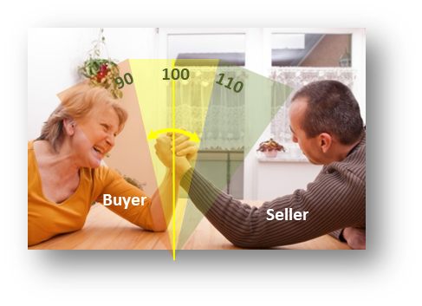
CROMFORD MARKET INDEX
CromfordReport.com
Tina Tamboer
Sr. Housing Analyst
Michael Orr
Founder

Slide 15
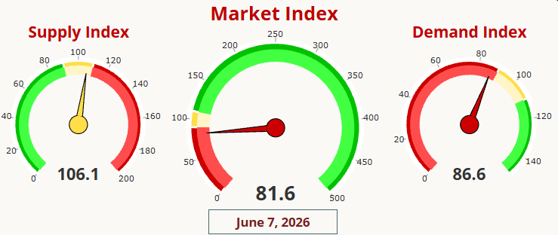

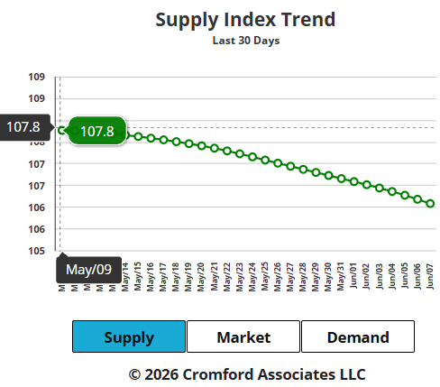
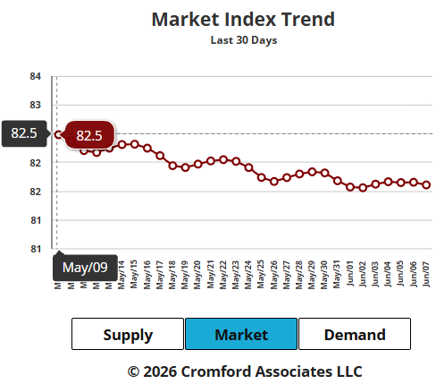
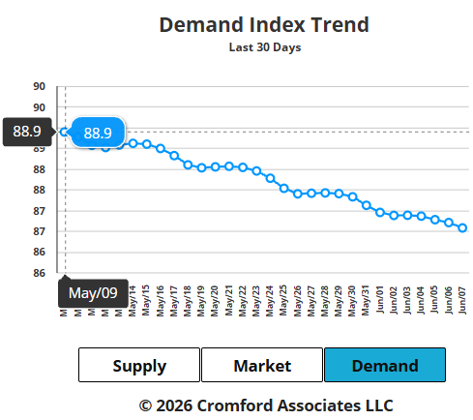
Cromford Market Index
CromfordReport.com
Tina Tamboer
Sr. Housing Analyst
Michael Orr
Founder
-1.7
-0.9
-1.4

Slide 16
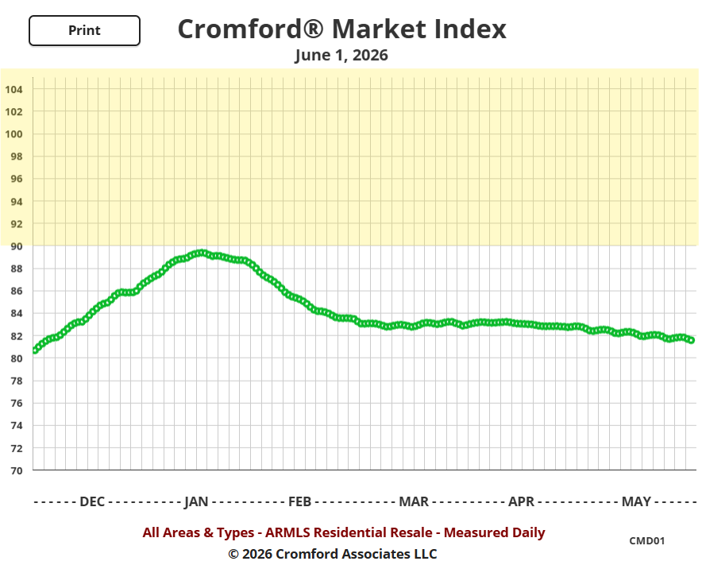

CromfordReport.com
Tina Tamboer
Sr. Housing Analyst
Michael Orr
Founder
Balanced Market
Buyer’s Market

Slide 17
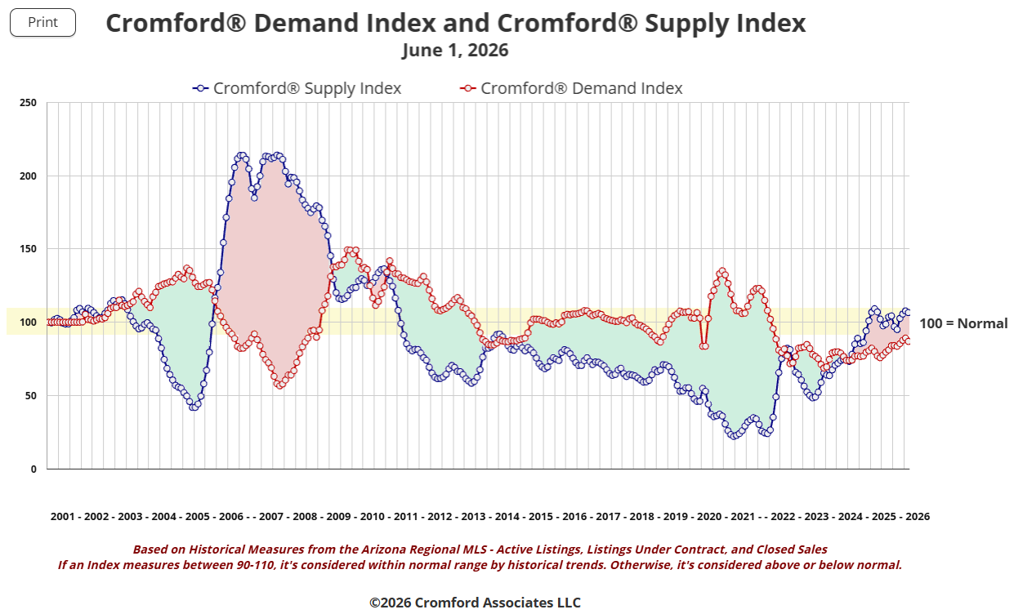
INDEXES
CromfordReport.com
Tina Tamboer
Sr. Housing Analyst
Michael Orr
Founder
Supply
Buyer’s Mkt (crash)
Demand
Demand
2013-2015
Supply
Seller’s Mkt
Seller’s Mkt
Seller’s Mkt
Balance
2019
Seller’s Mkt
Demand
Demand
Supply
Supply

Slide 18
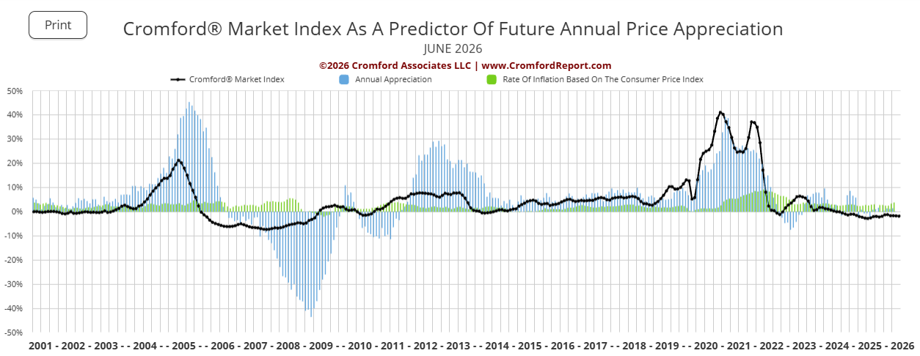
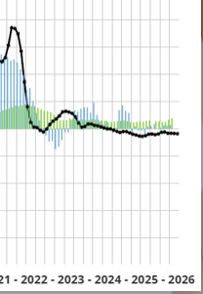
INDEXES
CromfordReport.com
Tina Tamboer
Sr. Housing Analyst
Michael Orr
Founder

Slide 19
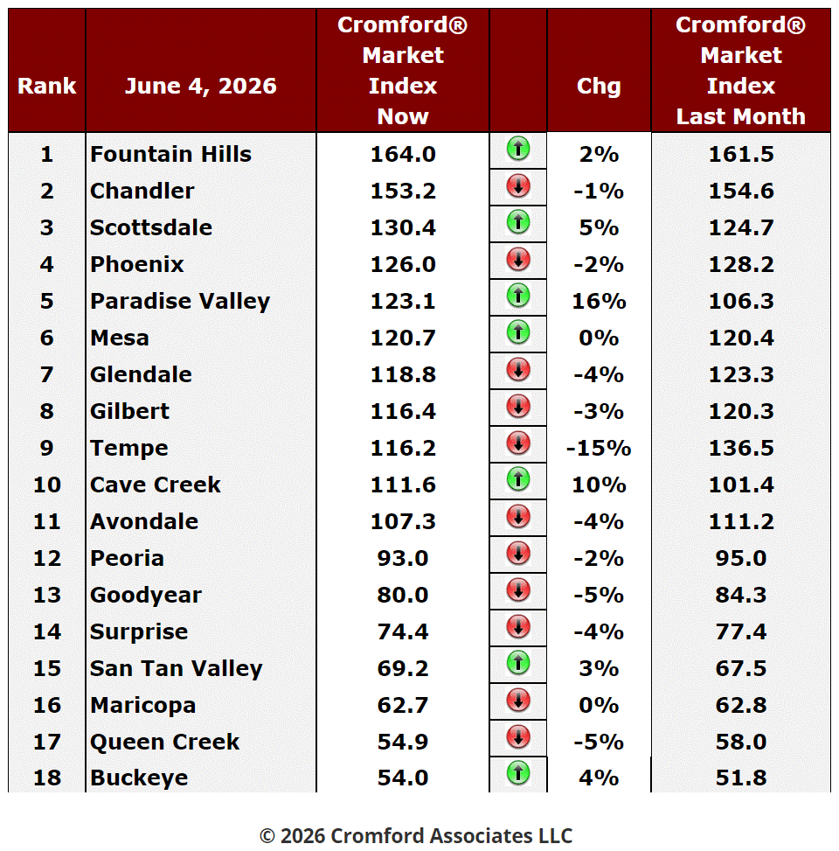
CROMFORD MARKET INDEX
CromfordReport.com
Tina Tamboer
Sr. Housing Analyst
Michael Orr
Founder
❖
Other Seller’s Markets
El Mirage (156.5)
Apache Junction (125.0)
Anthem (138.0)
Tolleson (114.0)
Other Balanced Markets
Sun City (97.0)
Sun City West (97.0)
Gold Canyon (91.5)
Other Buyer’s Markets
Laveen (85.4)
Sun Lakes (85.4)
Litchfield Park (64.3)
Arizona City (49.4)
Casa Grande (43.3)
⬥
◆
Seller’s Mkts
Balanced Mkts
Buyer’s Mkts

Slide 20

CROMFORD MARKET INDEX
BALANCED RANGE – 90-110
CromfordReport.com
Tina Tamboer
Sr. Housing Analyst
Michael Orr
Founder
Seller’s Markets:
Fountain Hills
Chandler
Apache Junction
El Mirage
Tempe
Phoenix
Glendale
Gilbert
Anthem
Scottsdale
Mesa
Tolleson
Paradise Valley
Cave Creek
Buyer’s Markets:
Goodyear
Surprise
San Tan Valley
Maricopa
Queen Creek
Buckeye
Laveen
Sun Lakes
Arizona City
Litchfield Park
Casa Grande
14
Balanced:
Avondale
Peoria
Sun City
Sun City West
Gold Canyon
11
5

Slide 21
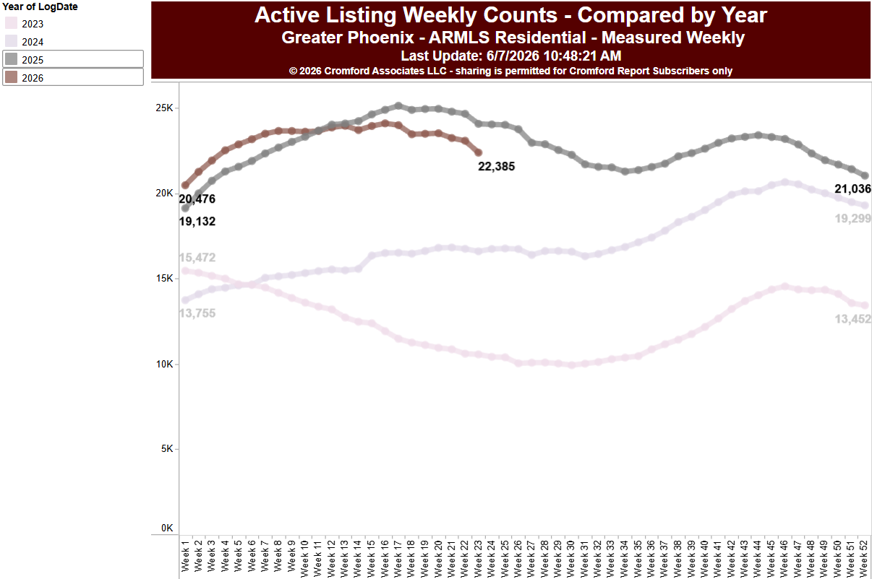
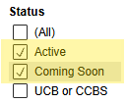
SUPPLY
CromfordReport.com
Tina Tamboer
Sr. Housing Analyst
Michael Orr
Founder
2025
2026
-7.0%
2024
2023

Slide 22
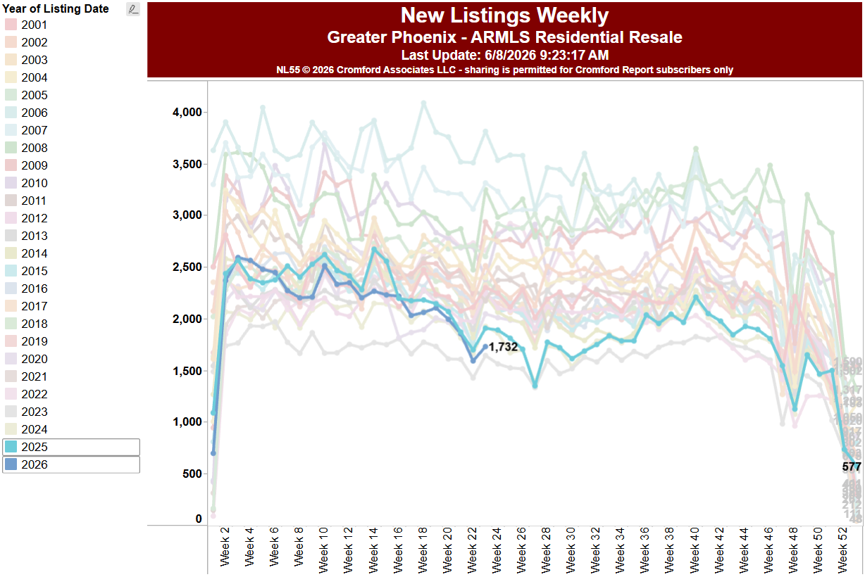
NEW LISTINGS WEEKLY
CromfordReport.com
Tina Tamboer
Sr. Housing Analyst
Michael Orr
Founder
2023
NEW LISTINGS WEEKLY
2001-2026

Slide 23
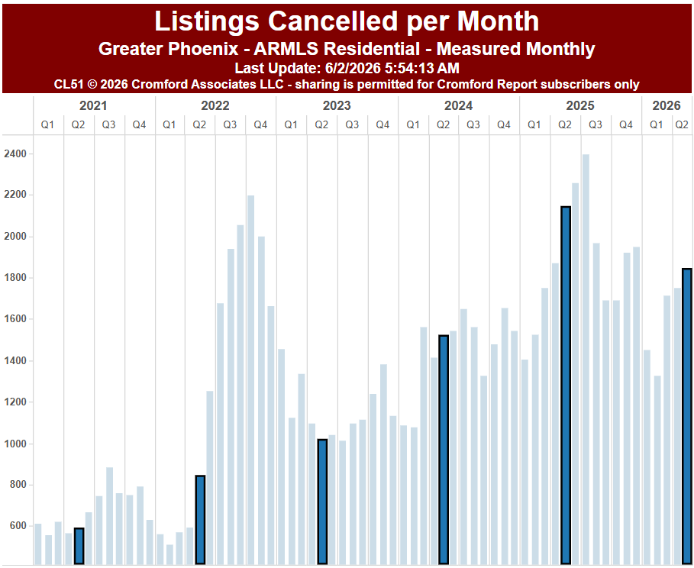
CANCELLATIONS
CromfordReport.com
Tina Tamboer
Sr. Housing Analyst
Michael Orr
Founder
2,136
-14%
1,836

Slide 24
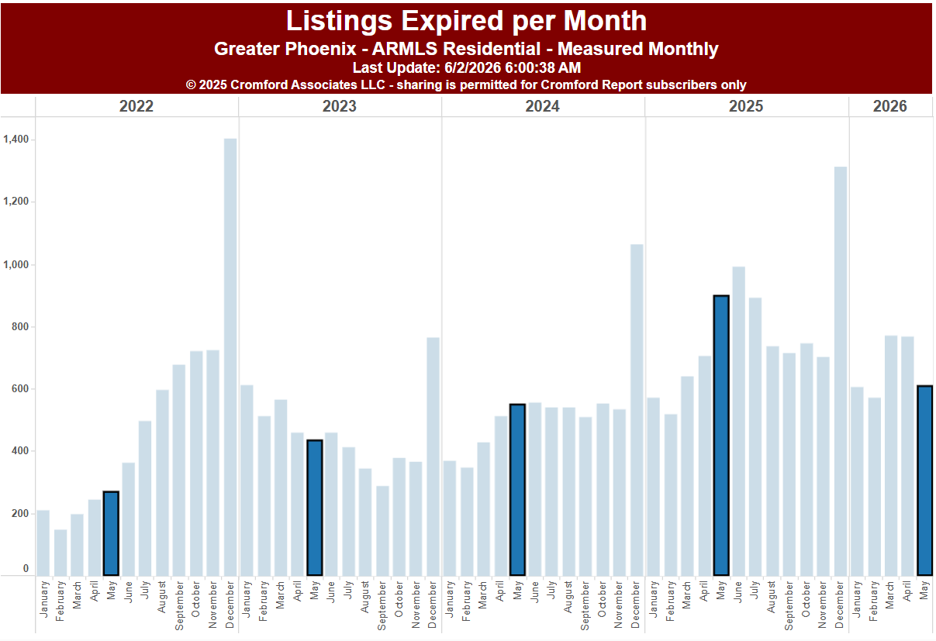
EXPIRED
CromfordReport.com
Tina Tamboer
Sr. Housing Analyst
Michael Orr
Founder
897
-32%
608

Slide 25
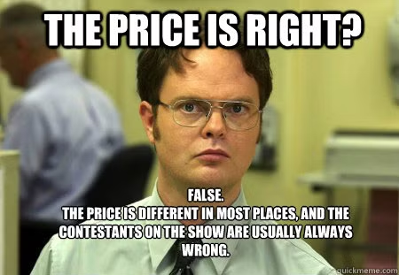
SALES PRICES
CromfordReport.com
Tina Tamboer
Sr. Housing Analyst
Michael Orr
Founder

Slide 26
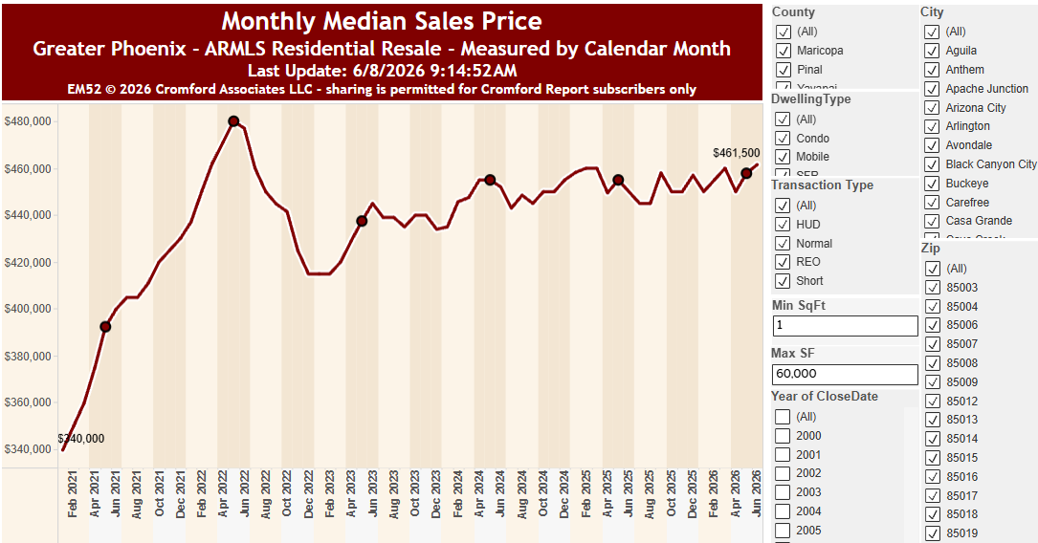

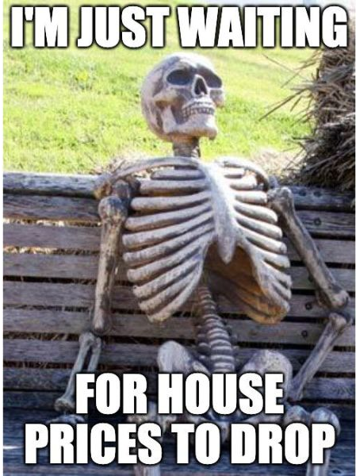
APPRECIATION - Median Sales Price
CromfordReport.com
Tina Tamboer
Sr. Housing Analyst
Michael Orr
Founder
May 2022
$480K
Jun = 5 of 21 Closing Days
May 2024
$455K
May 2025
$455K
-8.9%
0%
+4.0%
+0.6%
May 2023
$437.5K
Sales measures don’t tell us where we ARE, they tell us where we’ve ALREADY BEEN.
They reflect contracts written at least 4-6 weeks ago.
Sale prices are a trailing result, not a forecasting indicator.

Slide 27
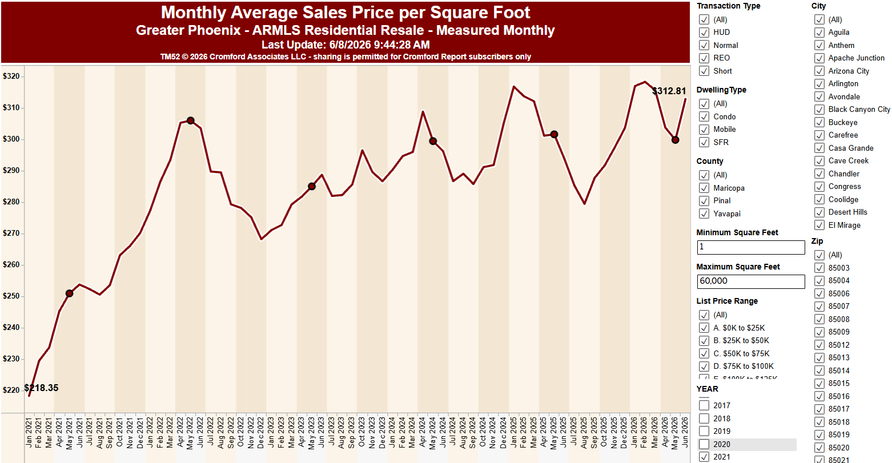

Avg Sales $/SF – Monthly Average
CromfordReport.com
Tina Tamboer
Sr. Housing Analyst
Michael Orr
Founder
Jun = 5 of 21 Closing Days
May 2022
$305.96
+0.8%
-0.6%
-6.8%
+5.1%
May 2024
$299.42
May 2025
$301.67
May 2023
$285.02
Sales measures don’t tell us where we ARE, they tell us where we’ve ALREADY BEEN.
They reflect contracts written at least 4-6 weeks ago.
Sale prices are a trailing result, not a forecasting indicator.

Slide 28
ARMLS APPRECIATION BY PRICE RANGE
SALES PRICE PER SQFT
CromfordReport.com
Tina Tamboer
Sr. Housing Analyst
Michael Orr
Founder
Price Range | 2025 May $/SF | 2026 May $/SF | % Difference
Under $300K | $186.23 | $181.84 | -2.9%
$300K-$400K | $229.51 | $226.29 | -1.4%
$400K-$500K | $241.63 | $235.88 | -2.4%
$500K-$600K | $257.50 | $256.37 | -0.4%
$600K-$800K | $281.59 | $279.59 | -0.7%
$800K-$1M | $313.01 | $316.20 | +1.0%
$1M - $1.5M | $388.32 | $385.78 | -0.7%
$1.5M - $2M | $474.76 | $451.52 | -4.9%
$2M - $3M | $550.22 | $585.61 | +6.4%
Over $3M | $877.70 | $802.33 | -8.6%
 | $301.58 | $299.81 | -0.6%
May 2026
20 of 20 Closing Days

Slide 29
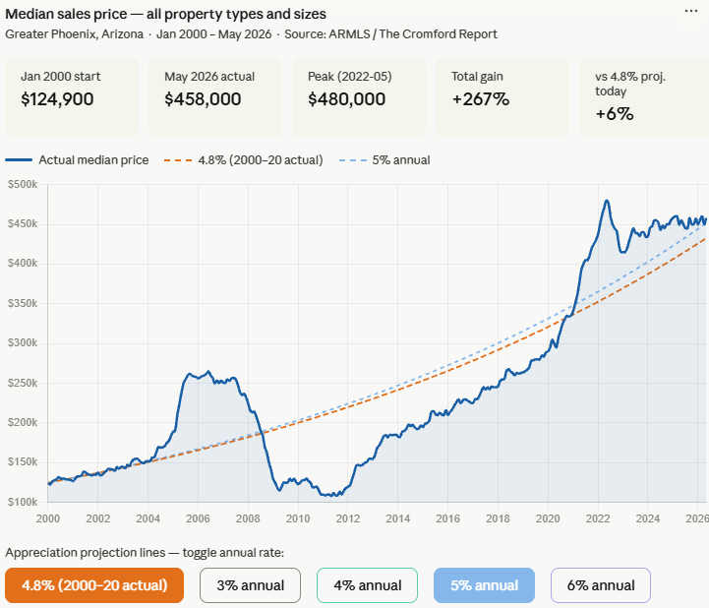


CromfordReport.com
Tina Tamboer
Sr. Housing Analyst
Michael Orr
Founder
+5.0%
BUYERS’ MEDIAN BUDGET
+4.8%

Slide 30
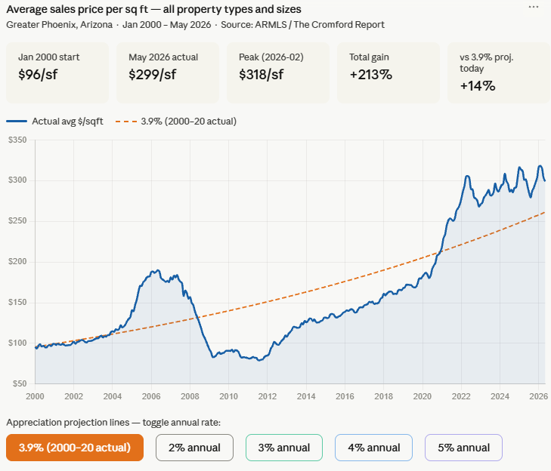


CromfordReport.com
Tina Tamboer
Sr. Housing Analyst
Michael Orr
Founder
+3.9%
LUXURY MARKET
IT WAS ME

Slide 31
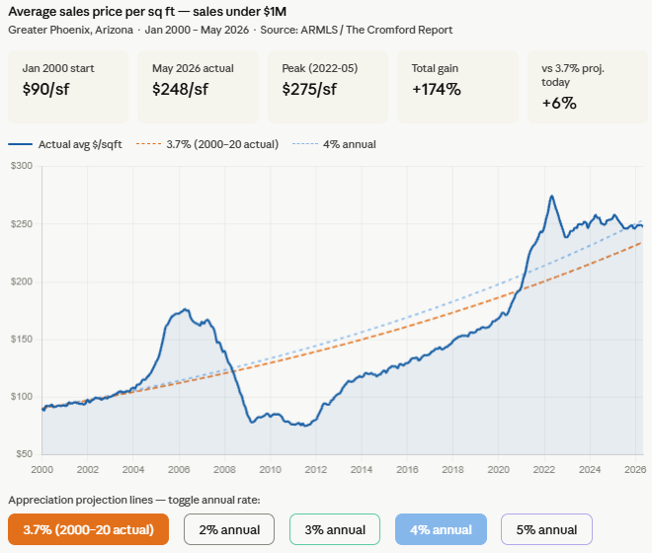

CromfordReport.com
Tina Tamboer
Sr. Housing Analyst
Michael Orr
Founder
SALES UNDER $1M
+4.0%
+3.7%

Slide 32
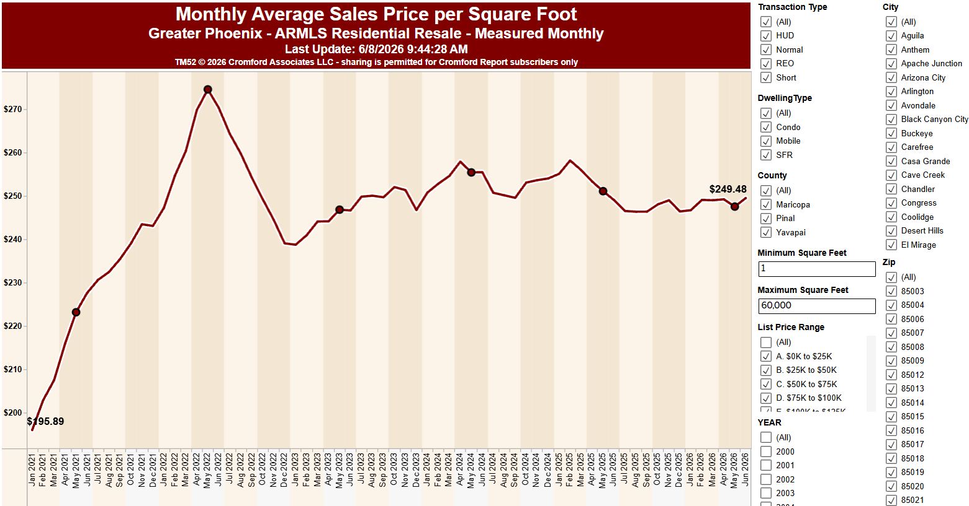

Avg Sales $/SF – Monthly Average
CromfordReport.com
Tina Tamboer
Sr. Housing Analyst
Michael Orr
Founder
May 2022
$274.57
-10.1%
-1.7%
Jun = 5 of 21 Closing Days
+3.5%
-1.4%
May 2024
$255.39
May 2025
$251.06
May 2023
$246.79
Monthly Average Price/SF
Homes Sold Under $1M
90.1% of Sales
Sales measures don’t tell us where we ARE, they tell us where we’ve ALREADY BEEN.
They reflect contracts written at least 4-6 weeks ago.
Sale prices are a trailing result, not a forecasting indicator.

Slide 33
Avg Sales $/SF – Monthly Average
CromfordReport.com
Tina Tamboer
Sr. Housing Analyst
Michael Orr
Founder
May 2022
$274.57
-9.8%
Jun = 5 of 21 Closing Days
May 2024
$255.39
May 2025
$251.06
May 2023
$246.79
Monthly Average Price/SF
Homes Sold Under $1M
90.1% of Sales
Sales measures don’t tell us where we ARE, they tell us where we’ve ALREADY BEEN.
They reflect contracts written at least 4-6 weeks ago.
Sale prices are a trailing result, not a forecasting indicator.

Slide 34
Avg Sales $/SF – Monthly Average
CromfordReport.com
Tina Tamboer
Sr. Housing Analyst
Michael Orr
Founder
May 2022
$274.57
Jun = 5 of 21 Closing Days
Jan 2022
$247.21
4.5 Years
Jul 2025
Monthly Average Price/SF
Homes Sold Under $1M
90.1% of Sales
Sales measures don’t tell us where we ARE, they tell us where we’ve ALREADY BEEN.
They reflect contracts written at least 4-6 weeks ago.
Sale prices are a trailing result, not a forecasting indicator.

Slide 35
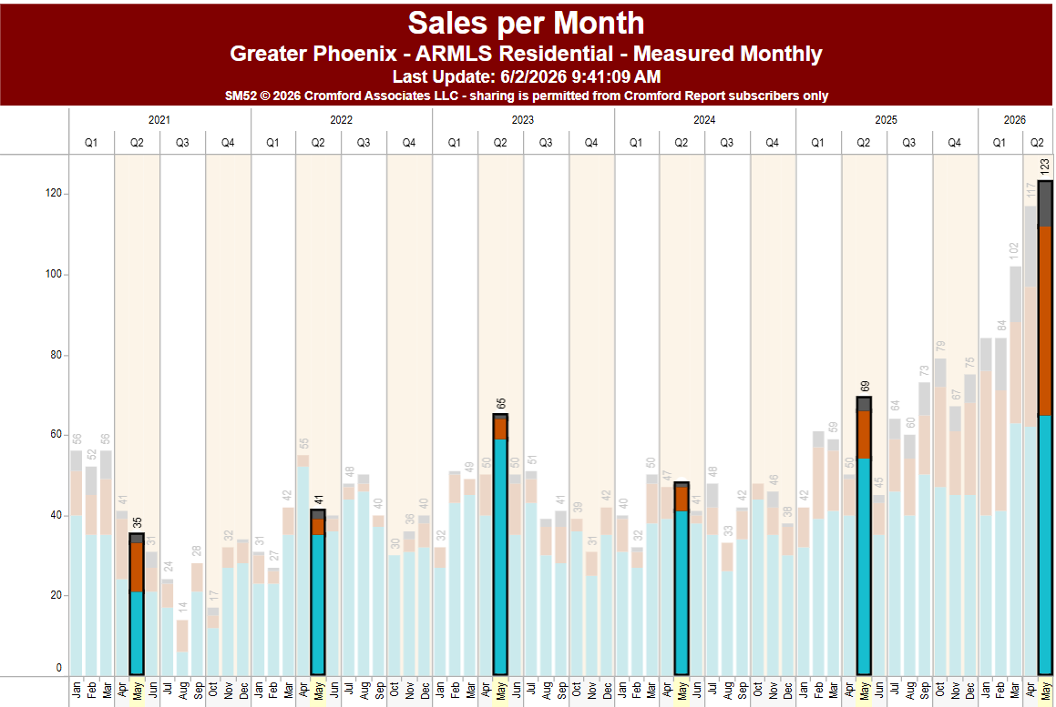
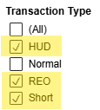
SALES
CromfordReport.com
Tina Tamboer
Sr. Housing Analyst
Michael Orr
Founder
May
+78%
In 1 year
DISTRESSED SALES
1.8% of Total MLS Sales
May
May
May
May
May

Slide 36
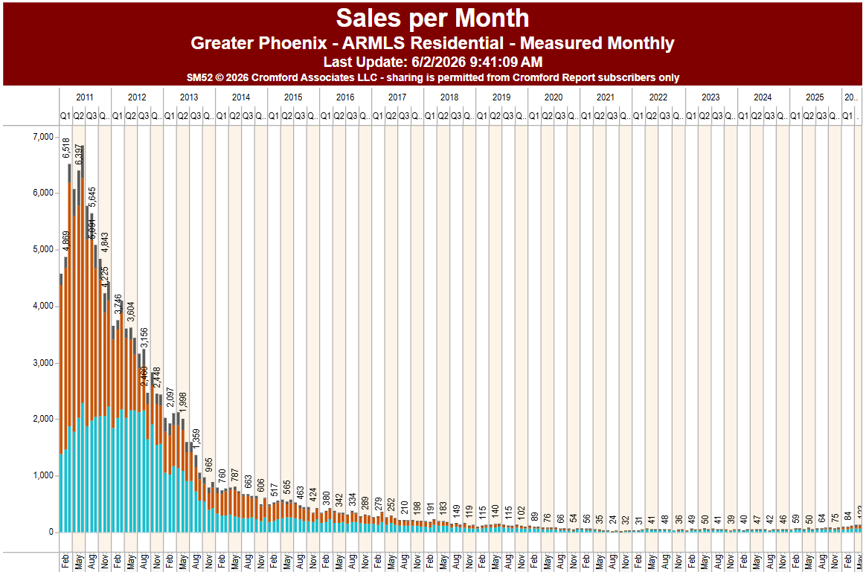
SALES
CromfordReport.com
Tina Tamboer
Sr. Housing Analyst
Michael Orr
Founder
You are here.
123

Slide 37
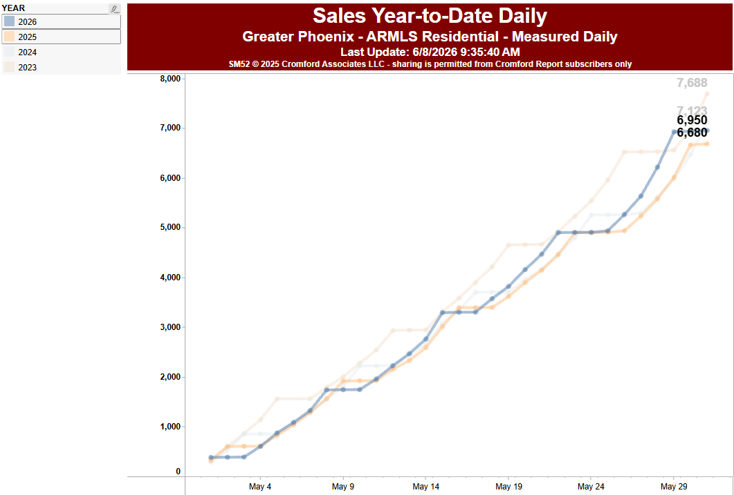
SALES
CromfordReport.com
Tina Tamboer
Sr. Housing Analyst
Michael Orr
Founder
2023
MAY SALES TO DATE
2026
2024
+4.0%
2025

Slide 38
ARMLS # SALES BY PRICE RANGE
Price Range | 2025 May Count | 2026 May Count | % Difference | # Difference
Under $300K | 824 | 936 | +13.6% | +112
$300K-$400K | 1,530 | 1,583 | +3.5% | +53
$400K-$500K | 1,542 | 1,542 | -0% | 0
$500K-$600K | 918 | 901 | -1.9% | -17
$600K-$800K | 907 | 916 | +1.0% | +9
$800K-$1M | 351 | 385 | +9.7% | +34
$1M - $1.5M | 283 | 346 | +22.3% | +63
$1.5M - $2M | 145 | 133 | -8.3% | -12
$2M - $3M | 89 | 104 | +16.9% | +15
Over $3M | 91 | 104 | +14.3% | +13
Total | 6,680 318.1/day | 6,950 347.5/day | +4.0% | +270 +29/day
CromfordReport.com
Tina Tamboer
Sr. Housing Analyst
Michael Orr
Founder
May 1-31, 2025 (21 working days)
vs.
May 1-31, 2026 (20 working days)

Slide 39
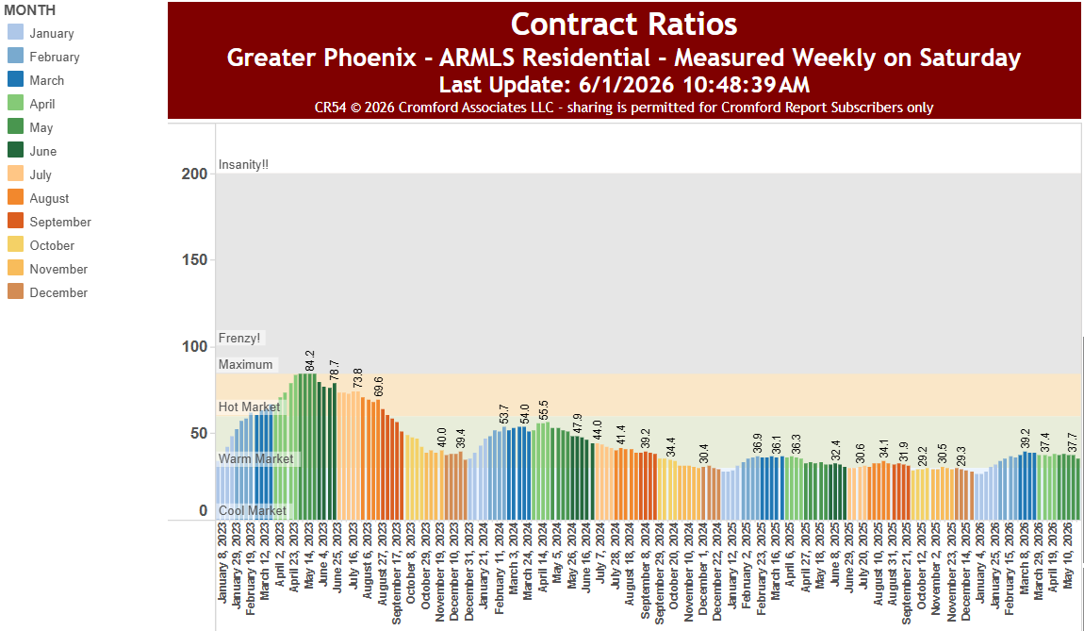

CONTRACT RATIO
CromfordReport.com
Tina Tamboer
Sr. Housing Analyst
Michael Orr
Founder
SEASONALITY
2026
May
2023
2025
May
2024
May
May
2025
2026

Slide 40
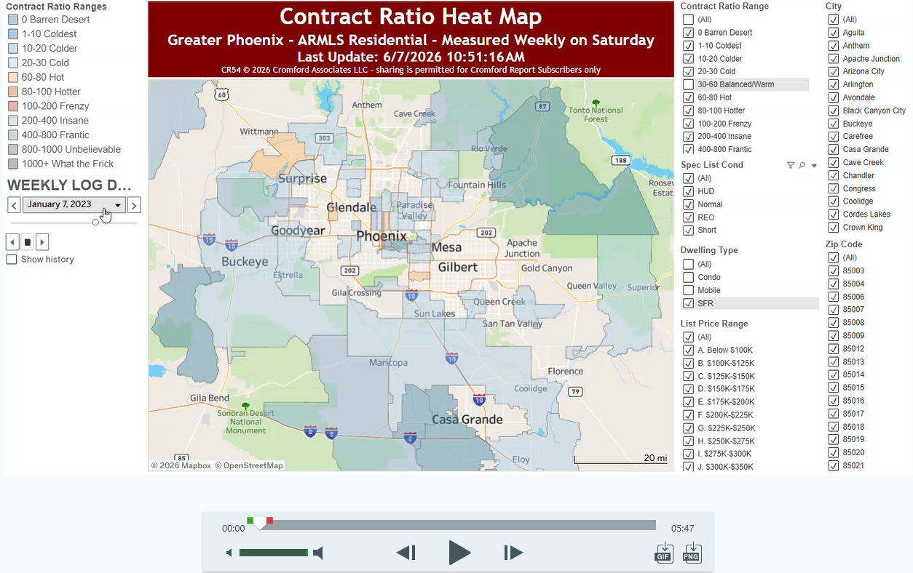
CONTRACT RATIO
CromfordReport.com
Tina Tamboer
Sr. Housing Analyst
Michael Orr
Founder

Slide 41
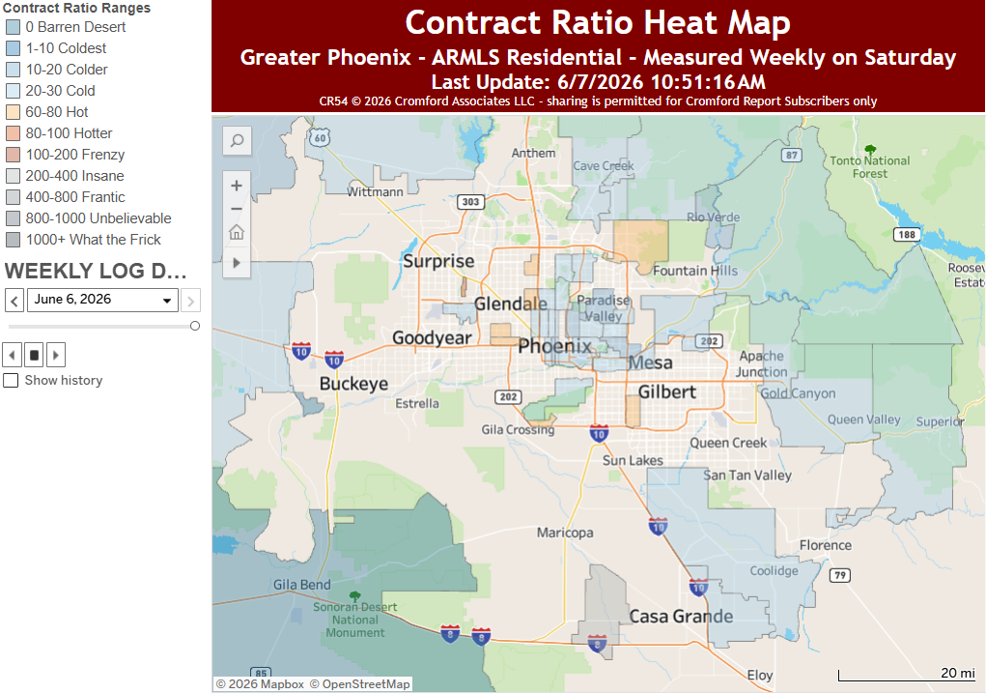
Contract Ratio
CromfordReport.com
Tina Tamboer
Sr. Housing Analyst
Michael Orr
Founder
Jun 6, 2026

Slide 42
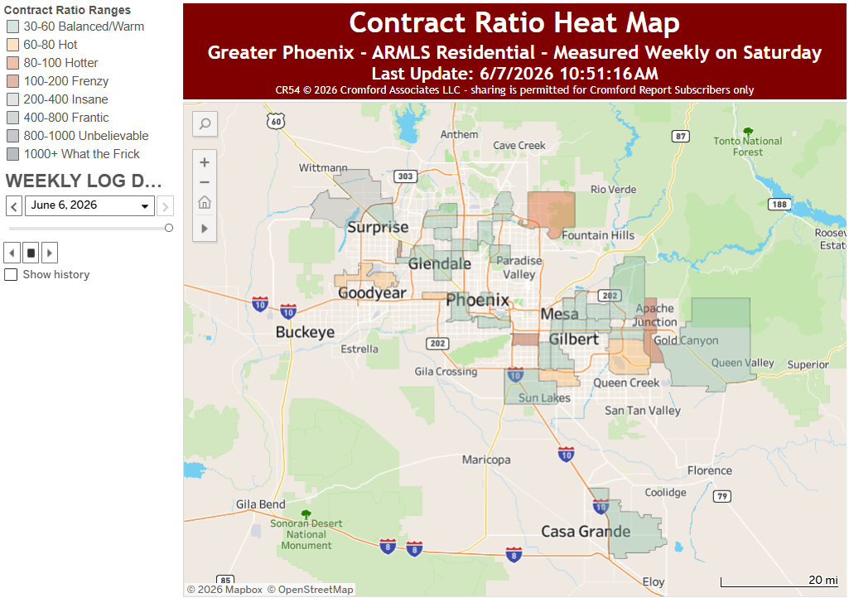

Contract Ratio
CromfordReport.com
Tina Tamboer
Sr. Housing Analyst
Michael Orr
Founder
CONDO/TH ONLY

Slide 43
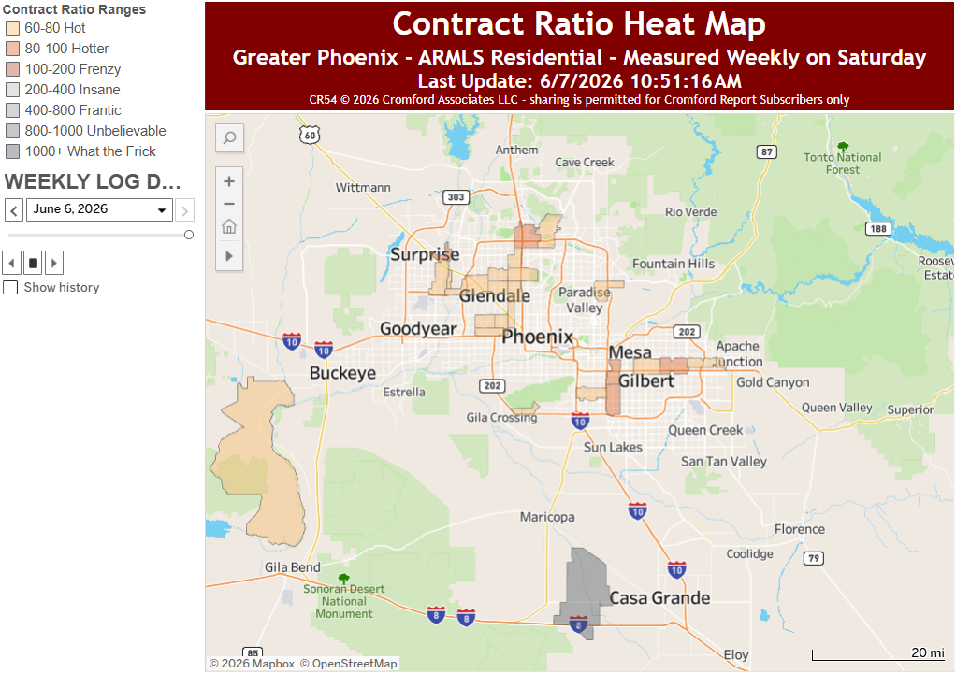
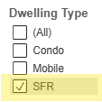
Contract Ratio
CromfordReport.com
Tina Tamboer
Sr. Housing Analyst
Michael Orr
Founder
SFR ONLY

Slide 44
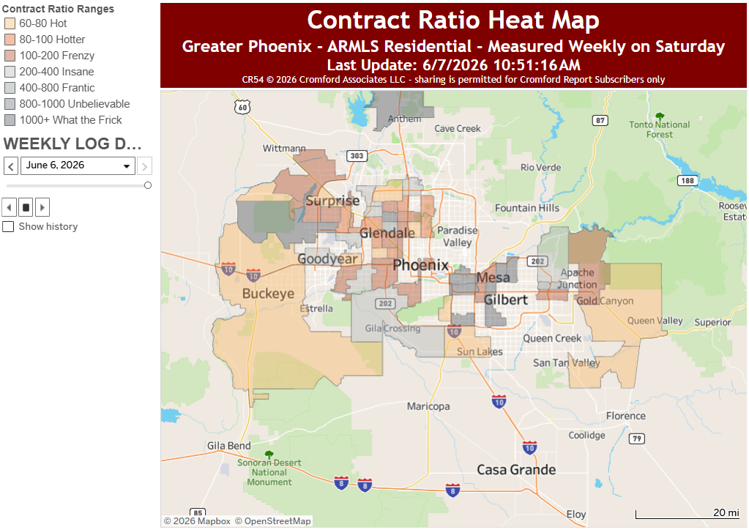
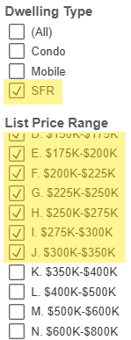
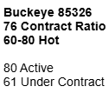

Contract Ratio
CromfordReport.com
Tina Tamboer
Sr. Housing Analyst
Michael Orr
Founder

Slide 45






Contract Ratio
CromfordReport.com
Tina Tamboer
Sr. Housing Analyst
Michael Orr
Founder

Slide 46


Contract Ratio
CromfordReport.com
Tina Tamboer
Sr. Housing Analyst
Michael Orr
Founder

Slide 47


Contract Ratio
CromfordReport.com
Tina Tamboer
Sr. Housing Analyst
Michael Orr
Founder

Slide 48


Contract Ratio
CromfordReport.com
Tina Tamboer
Sr. Housing Analyst
Michael Orr
Founder

Slide 49


Contract Ratio
CromfordReport.com
Tina Tamboer
Sr. Housing Analyst
Michael Orr
Founder

Slide 50


Contract Ratio
CromfordReport.com
Tina Tamboer
Sr. Housing Analyst
Michael Orr
Founder

Slide 51


Contract Ratio
CromfordReport.com
Tina Tamboer
Sr. Housing Analyst
Michael Orr
Founder

Slide 52


Contract Ratio
CromfordReport.com
Tina Tamboer
Sr. Housing Analyst
Michael Orr
Founder

Slide 53


Contract Ratio
CromfordReport.com
Tina Tamboer
Sr. Housing Analyst
Michael Orr
Founder

Slide 54


Contract Ratio
CromfordReport.com
Tina Tamboer
Sr. Housing Analyst
Michael Orr
Founder

Slide 55

MEANWHILE,
CromfordReport.com
Tina Tamboer
Sr. Housing Analyst
Michael Orr
Founder

Slide 56

PRICE REDUCTIONS
CromfordReport.com
Tina Tamboer
Sr. Housing Analyst
Michael Orr
Founder
3,448
-30.3%
2,403

Slide 57

DAYS ON MARKET – AT CONTRACT
CromfordReport.com
Tina Tamboer
Sr. Housing Analyst
Michael Orr
Founder
June to date
43
39
39
27
22
DOM at contract is always lower than DOM at close due to the UCB/CCBS statuses that are still considered “active” during the escrow period despite being under contract. Therefore, they continue to accumulate days on market until they’re placed in Pending status.
8
May
May
May
May
May

Slide 58


DAYS ON MARKET – AT CONTRACT
CromfordReport.com
Tina Tamboer
Sr. Housing Analyst
Michael Orr
Founder
June to date
63
CONDOS/TOWNHOUSES ONLY
56
46
32
23
DOM at contract is always lower than DOM at close due to the UCB/CCBS statuses that are still considered “active” during the escrow period despite being under contract. Therefore, they continue to accumulate days on market until they’re placed in Pending status.
8
May
May
May
May
May

Slide 59



CONCESSIONS
CromfordReport.com
Tina Tamboer
Sr. Housing Analyst
Michael Orr
Founder
May 2026
54%
June to date
53%
2025
2024
53%
2023
47%
43%

Slide 60

SALE PRICE TO LIST PRICE RATIO
CromfordReport.com
Tina Tamboer
Sr. Housing Analyst
Michael Orr
Founder
June to date 97.4%
97.9%
97.7%
May 2024
97.6%
May 2023
May 2025
97.2%
May 2026

Slide 61




RENTALS
CromfordReport.com
Tina Tamboer
Sr. Housing Analyst
Michael Orr
Founder
One Camelback's 163-unit luxury apartment complex opens for pre-leasing in early September
The ground floor will house 11,000 square feet of retail space with two leases pending
https://onecamelback.com

Slide 62


RENTALS
CromfordReport.com
Tina Tamboer
Sr. Housing Analyst
Michael Orr
Founder
Austin has seen the nation’s sharpest decline among large metros – the metro-wide median rent there has fallen 5.1 percent in the last 12 months and is down more than 20% from its 2022 peak. The Austin metro is also significant for permitting new homes at the fastest pace of any large metro in the country, indicating the impact of new supply on softening rents. Austin is not alone in exhibiting this trend; among the ten metros with the sharpest year-over-year rent declines, many also rank among the highest in terms of multifamily permits (e.g. San Antonio, Denver, Phoenix, Tampa, and Nashville).
https://www.apartmentlist.com/research/national-rent-data

Slide 63


RENTALS
CromfordReport.com
Tina Tamboer
Sr. Housing Analyst
Michael Orr
Founder
$1,570
$1,354
$1,061
8.1%
4.9%
3.1%
https://www.apartmentlist.com/research/national-rent-data

Slide 64

RENTALS
CromfordReport.com
Tina Tamboer
Sr. Housing Analyst
Michael Orr
Founder
Apartment Style
Under 1,100sqft
$1,295

Slide 65

RENTALS
CromfordReport.com
Tina Tamboer
Sr. Housing Analyst
Michael Orr
Founder
$290K
Apartment Style
Under 1,100sqft
$245K

Slide 66



RENTALS
CromfordReport.com
Tina Tamboer
Sr. Housing Analyst
Michael Orr
Founder
Apartment Style
Under 1,100sqft

Slide 67

RENTALS
CromfordReport.com
Tina Tamboer
Sr. Housing Analyst
Michael Orr
Founder
$2,250
Single Family
1,600-2,000sqft

Slide 68

RENTALS
CromfordReport.com
Tina Tamboer
Sr. Housing Analyst
Michael Orr
Founder
$495K
$450K
Single Family
1,600-2,000sqft

Slide 69




RENTALS
CromfordReport.com
Tina Tamboer
Sr. Housing Analyst
Michael Orr
Founder
Single Family
1,600-2,000sqft

Slide 70



RENTALS
CromfordReport.com
Tina Tamboer
Sr. Housing Analyst
Michael Orr
Founder
Top 20 Cities for ROI
Single Family Under 2,500sf*
*Based on 1 year of leases and 1 year of sales
*Does not include HOA costs, assumes cash purchase

Slide 71

RENTALS
CromfordReport.com
Tina Tamboer
Sr. Housing Analyst
Michael Orr
Founder
Annual Rental ROI
Single Family Under 2,500sf*
*Based on 1 year of leases and 1 year of sales
*Does not include HOA costs, assumes cash purchase

Slide 72
MARKET CONDITIONS
©2026 Cromford Associates LLC
CromfordReport.com
Tina Tamboer
Sr. Housing Analyst
Michael Orr
Founder
YEAR-OVER-YEAR: 12-Month Change - GREATER PHOENIX
May 2025 vs May 2026
 | MAY 2025 | MAY 2026 | Change
Avg. Sales Price per SqFt | $301.67 | $299.81 | -0.6% | ⬅➔ Neutral
Median Sales Price | $455,000 | $457,817 | +0.6% | ⬅➔ Neutral
Sales Over Asking Price | 14% | 15% | +1% | ⬅➔ Neutral
Seller % Concessions | 53% | 54% | +1% | ⬅➔ Good for Buyers
Seller $ Concessions | $10,000 | $10,000 | 0% | ⬅➔ Good for Buyers
Sale Price/List Price Ratio | 97.6% | 97.2% | -0.4% | ⬇ Good for Buyers
Median DOM Before Contract | 39 Days | 39 Days | 0 Days | ⬅➔ Good for Buyers
Closed Sales – MAY TO DATE Working Days Sales per Working Day | 6,680 21 of 21 318.1 | 6,950 20 of 20 347.5 | +270/+4.0% +29/day | ⬆ Good for SELLERS ⬆ Good for SELLERS
FOR UPDATES ON YOUR AREA SUBSCRIBE TO CROMFORDREPORT.com
Email us at Accounts@CromfordReport.com

Slide 73



Thank You!
CromfordReport.com
Tina Tamboer
Sr. Housing Analyst
Michael Orr
Founder
  www.CromfordReport.com
Michael Orr
Founder of the Cromford Report
Mathematician
mike@cromfordreport.com
Tina Tamboer
Director, Greater Phoenix Operations
Sr. Residential Housing Analyst
tina@cromfordreport.com

Slide 74
The Cromford Report
CromfordReport.com
Tina Tamboer
Sr. Housing Analyst
Michael Orr
Founder
    For a copy of this PowerPoint and to customize any of these charts for your area, subscribe to The Cromford® Report online:
    To subscribe go to www.CromfordReport.com or email us at Accounts@CromfordReport.com and we will send you a link.
      Sign Up – select ARMLS Subscription
        Monthly - $35
        Quarterly - $90 (save $60/year)
        Annually - $300 (save $120/year)
    Cromford® Public - $240/Year ($150 with Cromford Report Subscription)

